Slide 1

UNIT
DAY 10
01
COMMIT AND DRAW
GAMES OF LOGIC
AGENDA
REMINDERS
Phones into The Holding Cell
Paper, pencils, rulers, rubric sheet
What Today Is
What You Hand In
How It Is Marked
How To Justify
The Three Drawings
The Work, In Order
Checklist
RECOMMENDED LISTENING:
THE MARIO DRAWING SONG – MARIO KART WORLD

Slide 2
WHAT TODAY IS
Today you commit to one of your three ideas, and draw it well enough that somebody else could build it
Nothing new gets designed. That work happened last lesson
Everything today will go onto five folder slides, and those five get marked together with slides 13 to 16
Your specification locks at the end of today

Slide 3
WHAT YOU HAND IN TODAY
Folder slide 17 - your chosen design, justified against your own specification
Folder slide 18 - your component drawings, with sizes and a count
Folder slide 19 - your table, drawn from where each player sits
Folder slide 20 - every icon, drawn once, with what it means
Folder slide 21 - your requirements list
All five are Criterion B. The bands are on your Criterion B rubric sheet

Slide 4
HOW TODAY IS MARKED
Criterion B, strands iii and iv. The full scale is on your Criterion B rubric sheet
STRAND | WHAT AN 8 LOOKS LIKE | THE TRAP
iii | justifies fully and critically, with detailed reference to the specification | Only saying what is good about your choice caps you at a 6
iv | accurate and detailed planning drawings, and outlines the requirements | The bottom band says drawings or requirements. Skip slide 21 and you are stuck down there

Slide 5
HOW TO JUSTIFY YOUR CHOICE
Identify one of your spec lines, then say how that influences your choice
"Spec line 3 caps me at ten minutes, and idea 1 had four rounds of scoring in it" is a justification
"I picked idea 2 because it looked best" is a preference, not a justification
Work through the spec line by line, not in general terms, you can literally number them
Say what you kept from the two ideas you dropped
→ FOLDER SLIDE 17

Slide 6
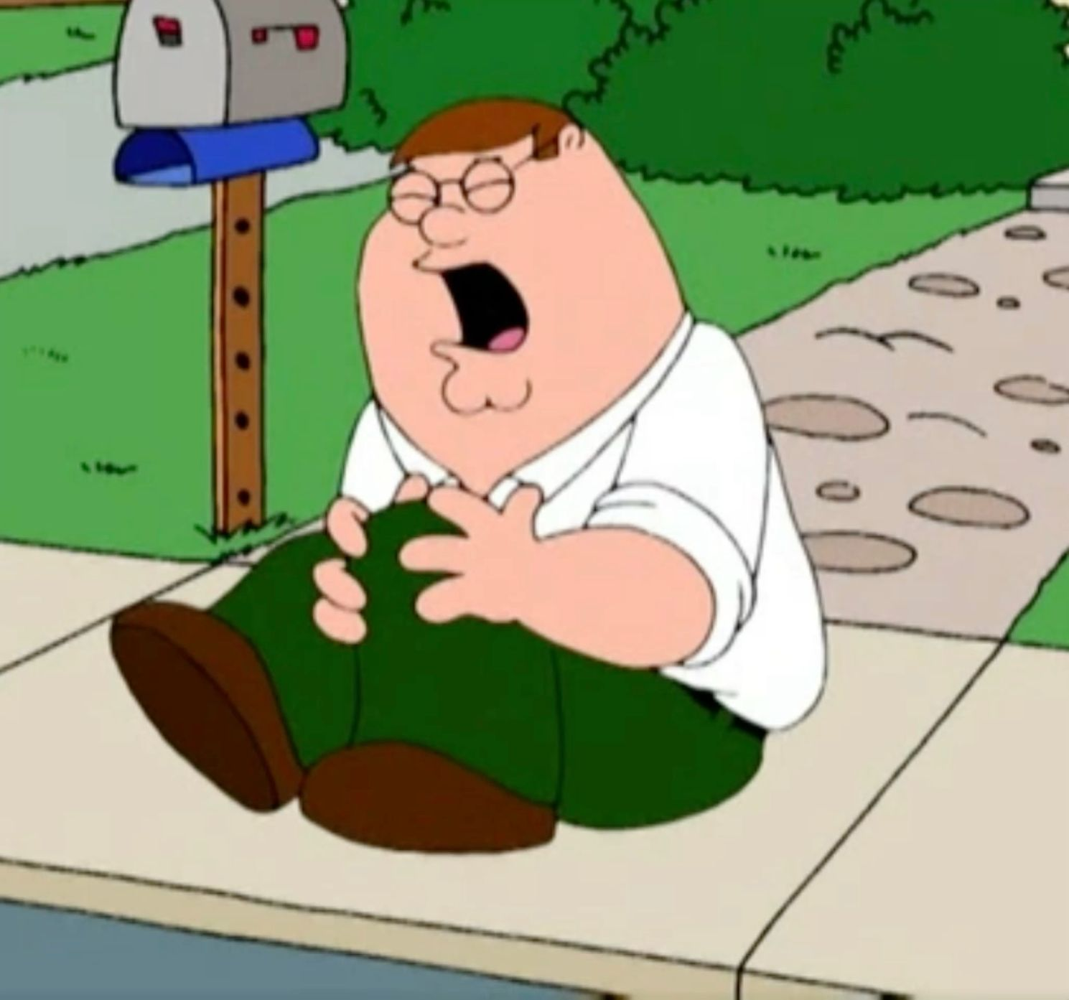
NAMING YOUR WEAKEST SPEC LINE
Name the numbered spec line your design is perhaps the weakest at
"Weakest on line 1, the time to teach, because the scoring rule needs a worked example"
→ FOLDER SLIDE 17

Slide 7

DRAWING 1 - YOUR COMPONENTS
Every card, tile and token, drawn flat
Fronts and backs. The back is what everyone stares at all game
Sizes in mm on every one. A playing card is 63 by 88
Label what each part of the card is for
→ FOLDER SLIDE 18

Slide 8
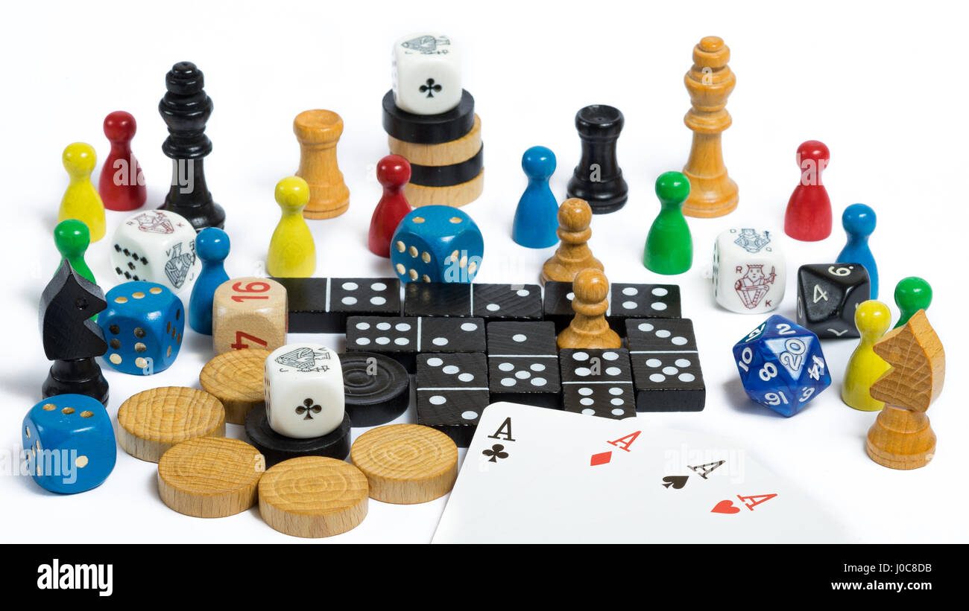
COUNTING YOUR COMPONENTS
Count them once drawing 1 is done. Cards, tiles and tokens added together
An exact number should go onto slide 18 (“about fifty" is not a number)
24 number, 12 action, 4 reference, 8 tokens, 1 marker is 49. Six more action cards makes 55
If your design is over 54 you need to revise your design, not the spec. Cut whatever is not important
→ FOLDER SLIDE 18

Slide 9
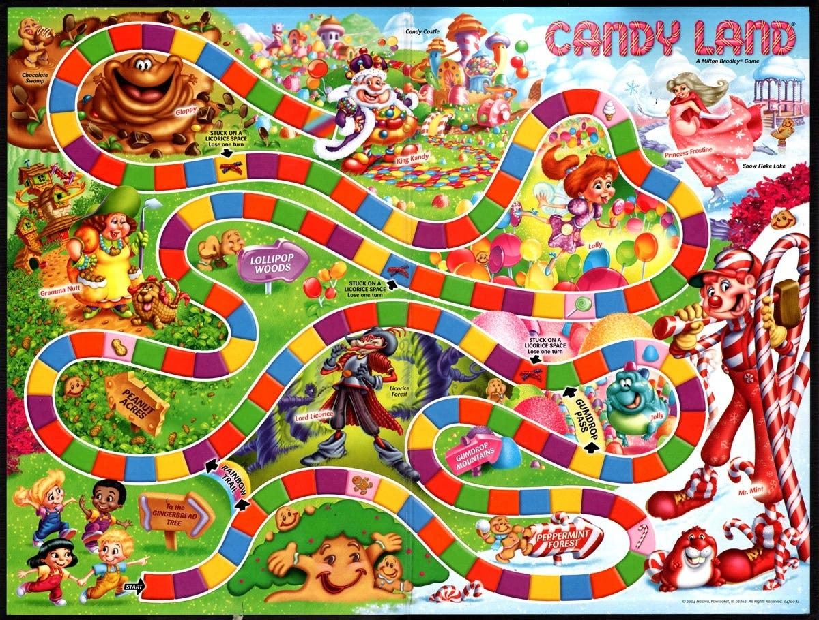
DRAWING 2 - THE TABLE
The whole table, full size, as it looks while the game is being played
Where each player sits, what is in front of them, and what is face down
Draw it from each seat. What seat 1 can read is not what seat 3 can read
No board? This is still the drawing. The table is the layout
→ FOLDER SLIDE 19

Slide 10
DRAWING 3 - YOUR ICONS
Draw every symbol or icon your game uses, at the size it will actually print
Write what it means next to it
Ideally, your cards will use symbols, rather than large blocks of text, to convey information
→ FOLDER SLIDE 20

Slide 11
THE REQUIREMENTS LIST
Three columns on folder slide 21: what you need, how many, and where it comes from
"Card" is not a requirement. "40 blank playing cards" is a requirement
Software counts, and so does anything you are buying or borrowing
The rules sheet is a requirement
Ask yourself: could somebody else fetch all of it without asking you a question
→ FOLDER SLIDE 21

Slide 12
LOCKING THE SPEC
Put today’s date on folder slide 13 before you leave
After that, changing your specification means talking to me first
  For Criteria D, you evaluate your own game against this spec
If you can quietly edit it once you have seen your results, the evaluation becomes meaningless
→ FOLDER SLIDE 13

Slide 13
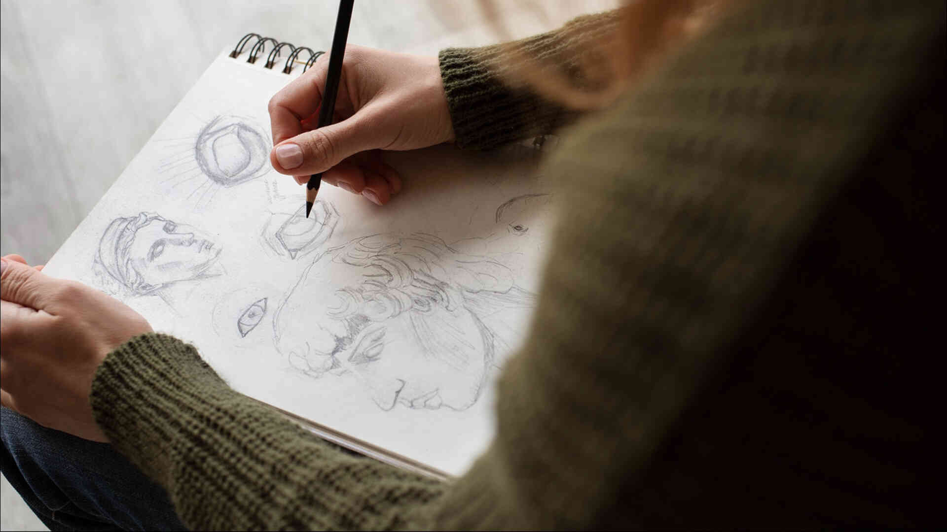
THE WORK, IN ORDER
0:27 to 0:39 - folder slide 17, the justification
0:39 to 0:59 - folder slides 18, 19 and 20, the three drawings
0:59 to 1:06 - the count onto slide 18, then slide 21
1:06 to 1:14 - the four checks, then photograph everything in
1:14 to 1:17 - date folder slide 13
Ask me anything during any of it

Slide 14
THE FOUR CHECKS
Does every component have a size on it
Is the count on folder slide 18, and is it 54 or fewer
Is every icon drawn once, with its meaning next to it
Does the table drawing show what each seat can see
Don’t try to update your slides until all of your drawings are complete

Slide 15
IF YOU MISSED TODAY
The drawings will take some time, but should be easy to catch up on
1. Folder slide 17 - argue your choice against the spec line by line, ending with your weakest line
2. Folder slides 18, 19 and 20 - components with sizes, the table from each seat, every icon once
3. Count onto folder slide 18 and check it is 54 or fewer
4. Folder slide 21 - the requirements list, with quantities
5. Date folder slide 13, and see me before changing anything on it after that

Slide 16
CHECKLIST BEFORE YOU LEAVE
Swap with somebody and read their requirements list. Could you go and fetch all of it
Folder slides 17, 18, 19, 20 and 21 all have something on them
Folder slide 13 is dated
Next time:
  The production plan

